Slide 1



SAP Process Integration
System Landscape Directory
16th - 20th March, 2020
Trainer: Gopal
Kirti

Slide 2


System Landscape Directory
Agenda
1
Overview
Content Type
Data Suppliers
Data Consumers
SLD and Enterprise Service Repository
SLD and Integration Directory
Topology
2
3
4
5
6
7
Copyright © Capgemini 2016 All Rights Reserved
2

Slide 3


Overview
Copyright © Capgemini 2016. All Rights Reserved
11

Slide 4
Overview
SLD is the central repository of information about the software and hardware systems in the data center (customer landscape) expressed in a standard schema called the CIM (Common Information Model).
CIM was developed by Distributed Management Task Force or DMTF (an industry consortium whose goal is to allow IT systems management in distributed environments using web standards) to model hardware and software elements in order to describe management information by using object oriented modeling approach.
Copyright © Capgemini 2016. All Rights Reserved
9

Slide 5
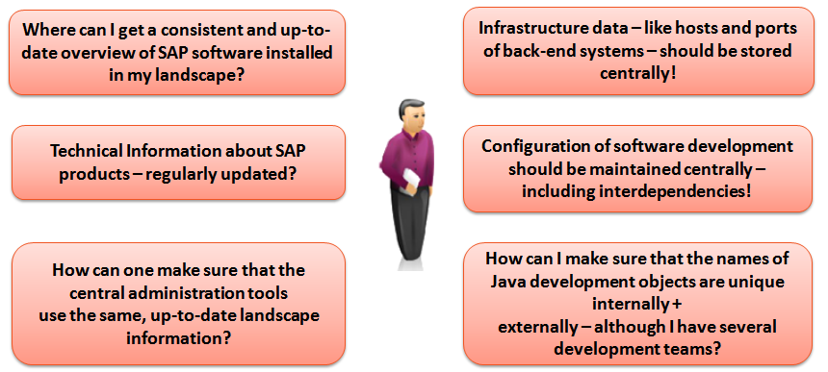
Overview
Challenges addressed by SLD
Copyright © Capgemini 2016. All Rights Reserved
9

Slide 6
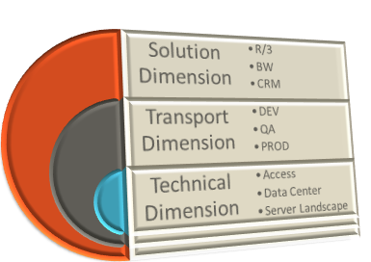
Overview
The Three Dimensions
System Landscapes have three dimensions:
Solution Dimension – what software processes are installed
Transport Dimension – DEV, QA, PROD
Technical Dimension – what products are installed on which hosts on particular networks
The SLD should capture all three dimensions of the System Landscape
Copyright © Capgemini 2016. All Rights Reserved
9

Slide 7
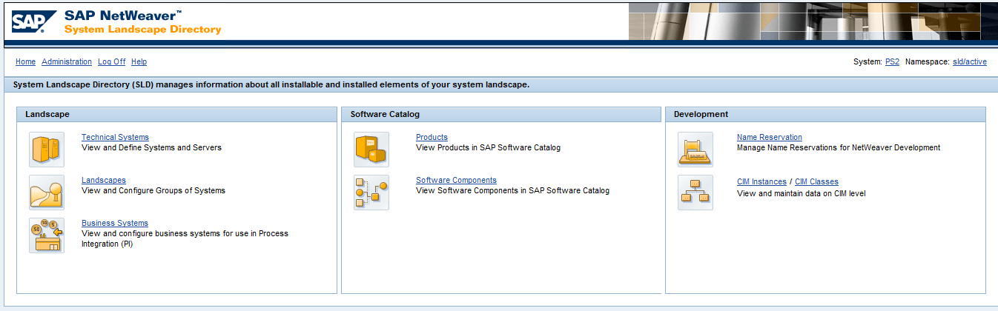
Overview
SLD Initial Page
Copyright © Capgemini 2016. All Rights Reserved
9

Slide 8
SLD Content Type
Copyright © Capgemini 2016. All Rights Reserved
11

Slide 9
SLD Content Type
Catalogs
The two main areas of SLD are the Software Catalog and the Landscape Description.
The Software Catalog describes the installed products and their constituent components. The software catalog is delivered with content about all SAP products. Customers and Partners can extend this catalog with information about software from other vendors. It describes the component information, possible combinations and dependencies.
The Landscape Description describes the systems in the data center from two perspectives: a logical view (business systems) and a physical view (technical systems). It describes the concrete implementation of the customer landscape.
Copyright © Capgemini 2016. All Rights Reserved
9

Slide 10
SLD Content Type
Functioning of SLD
Importing/synchronizing PPMS data as XML file into Master Component Repository at the SAP site.
The Master Component Repository contains the up-to-date information about all SAP products. This will be published on the Service Market Place and Customers can update their individual component information. They can also add additional information about the 3rd party products which are in operation into their individual component information.
The Landscape description contains information about all installed products/components at the Customer site.
Applications and Tools can use information from the SLD as the central information provider.
Copyright © Capgemini 2016. All Rights Reserved
9

Slide 11
SLD Content Type
Products and Software Components
The component information is based on Software Products and their versions, Software Component and their versions .
The association between software product and its constituent components is described in the SLD by an association called a software feature.
Software Component : It is unit of software delivery that has its own support package track. (Ex: SAP_HR, SAP_BASIS etc.)
Product : A software product comprises of one or more software components. (Ex: SAP R/3)
Software Component Version : It represents a particular version of the SWC.
Product Version : It represents a particular version of the product. (Ex: SAP R/3 4.6c, 4.6d, 4.7
Copyright © Capgemini 2016. All Rights Reserved
9

Slide 12
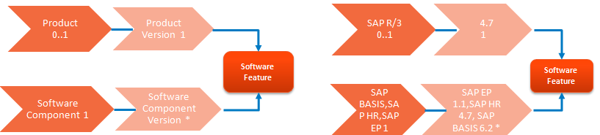
SLD Content Type
Products and Software Components
Each product version consists of multiple software features which are implemented by various software components (versions).
The internal PPMS (SAP Product and Production Management System) provides the data for SWC and software products for SAP products.
SAP provides this master data for updating the local component information. Using data import current data is added to SLD.
Defining third party products and software components is easy in SLD, because of the wizards that guide you through the process
Copyright © Capgemini 2016. All Rights Reserved
9

Slide 13
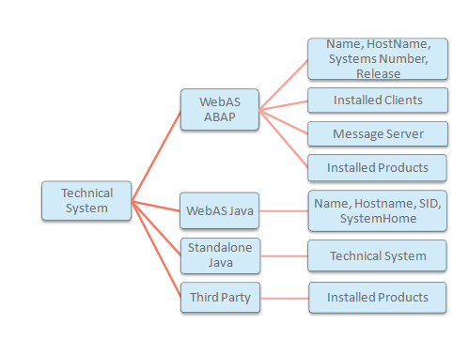
SLD Content Type
Technical Systems
Technical Systems are defined in the Systems catalog. Technical System corresponds to the physical details of the system in which the software is installed.
Types of Technical System
- Web AS ABAP
- Web AS Java
- Standalone Java
- Third-Party
A Technical System may have multiple products installed on it.
Copyright © Capgemini 2016. All Rights Reserved
9

Slide 14
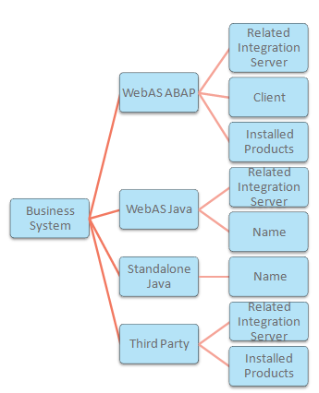
SLD Content Type
Business Systems
Business systems are logical senders / receivers that exchange messages by using SAP PI and these are entered in the System Landscape Directory.
Technical Systems are the basis for defining Business systems. SLD defines the association between Technical and Business Systems.
The association between the Technical and Business systems depend upon the type of the Technical System.
Copyright © Capgemini 2016. All Rights Reserved
9

Slide 15
SLD Data Suppliers
Copyright © Capgemini 2016. All Rights Reserved
11

Slide 16
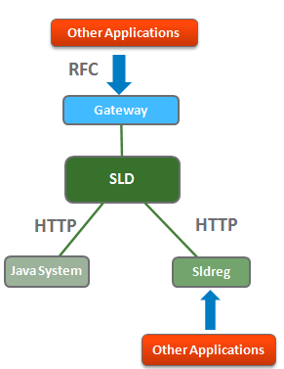
SLD Data Suppliers
How does SLD gets Landscape Description?
SAP systems contains Data Suppliers that collect and send data to SLD.
This must be configured per landscape element
Once configured, it sends reliable and up to date data automatically. It can configured :
- At system startup
- Periodically (batch job)
Data suppliers will be configured in end systems.
- ABAP system data (transaction RZ70)
- Java system data (SLD data supplier service)
- Host data (SAPOSCOL)
- Other system data (sldreg)
Copyright © Capgemini 2016. All Rights Reserved
9

Slide 17
SLD Data Consumers
Copyright © Capgemini 2016. All Rights Reserved
11

Slide 18
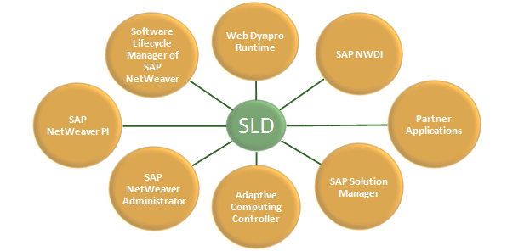
SLD Data Consumers
Overview
Copyright © Capgemini 2016. All Rights Reserved
9

Slide 19
SLD Data Consumers
SAP NetWeaver PI
Main use cases of SAP NetWeaver PI is for providing business system names and provides transports targets for content transports of PI
Development and Design of interface in PI are derived from the contents of SLD
SLD maps “business system name” to “technical system” so that PI can identify receiver of the message.
Web Dynpro
WebDynpro requires SLD for adaptive RFC calls.
SAP Solution Manager
SLD provides solution manager with the details of the ABAP and Java system in the landscape.
Copyright © Capgemini 2016. All Rights Reserved
9
Notes:
SAP NetWeaver Process Integration (PI)
SAP platform for process integration using the interchange of XML messages
Former name: SAP NetWeaver Exchange Infrastructure (SAP NetWeaver XI)
Web Dynpro requires SLD for adaptive RFC calls
SLD stores back-end connection data centrally
Changes in landscape need only be reflected in SLD. For example, after move of a back-end system, infrastructure data has only to be updated in SLD, not in all applications communicating with this back-end system
SAP NetWeaver Development Infrastructure (NWDI) provides the environment for all processes of Java-based development and Java-based software life-cycle management
SAP Solution Manager
Platform that provides integrated content, tools, and methodologies that one required to implement, support, operate and monitor enterprise solutions from SAP
Provides a data repository for system data on its own.
SAP Solution Manager can either:
Use SLD as data repository for SAP Solution Manager
Use it’s own data repository

Slide 20
SLD Data Consumers
SAP NetWeaver Development Infrastructure (NWDI) :
To develop Java code, SLD provides :
- Definition for the software products and software component
- Naming service
- Storage of development configuration required for development
SAP NetWeaver Administrator
- Tool for administration and monitoring, which offers a central entry point to whole SAP NetWeaver system landscape
- Requires SLD for remote monitoring functions
- During SLD downtime, central administration of systems is not possible
Copyright © Capgemini 2016. All Rights Reserved
9
Notes:
Information that is stored in SLD is important for further applications in the production landscape

Slide 21
SLD and ESR
Copyright © Capgemini 2016. All Rights Reserved
11

Slide 22
SLD and Enterprise Services Repository
All design/development work in the ESR (Enterprise Service Repository) is organized by SWC version. This makes us understand the interfaces logically belong to a SWC and to a particular version.
Before development begins, the SWCVs’ must be imported from the SLD to the Enterprise Service Repository.
As the Local Software component is not having any link with SLD or ID, it is used only for testing purpose. Wherever development of interfaces is concerned SWCV’s imported from the SLD only can be used.
Additionally when we define integration scenarios in the ESR, the application components that we assign in the scenario editor are assigned from product versions in the SLD.
Copyright © Capgemini 2016. All Rights Reserved
9

Slide 23
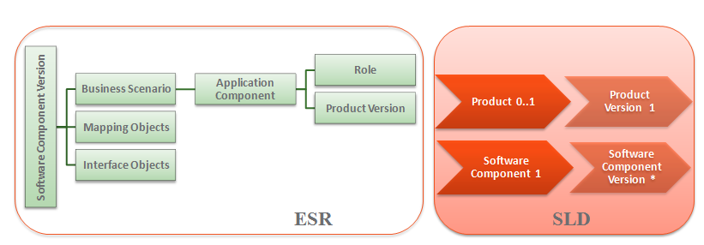
SLD and Enterprise Services Repository
Dependencies between SWCVs’ can be created in the SLD and these dependencies will automatically be reflected in ESR.
Copyright © Capgemini 2016. All Rights Reserved
9

Slide 24
SLD and ID
Copyright © Capgemini 2016. All Rights Reserved
11

Slide 25
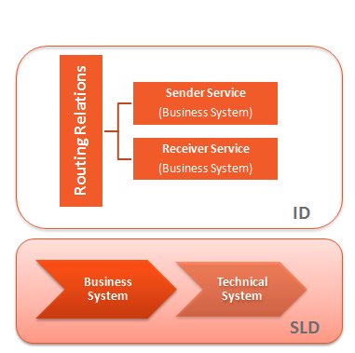
SLD and Integration Directory
A collaborative process is set up at configuration time for a specific system landscape. The configuration data is organized, structured, and saved in ID (Integration Directory) in form of configuration objects.
A Service is used to address a sender or receiver of messages during the configuration time.
It is possible to address a particular Business System as a service.
Copyright © Capgemini 2016. All Rights Reserved
9

Slide 26
SLD and Integration Directory
A Business System (BS) is a logical system that represents (actual end application system which is participating in the integration) sender/receiver systems in SLD.
A Business System (service) has information about the inbound/outbound interfaces and the SWC versions of the business system.
Business system services are used when configuring internal company processes.
Routing Relations in the ID point to the Business Systems (BS) that are maintained in the systems catalog in the SLD, and through appropriate association, to the technical systems.
Copyright © Capgemini 2016. All Rights Reserved
9

Slide 27
Topology
Copyright © Capgemini 2016. All Rights Reserved
11

Slide 28
Topology
Reasons to have Several SLD
The following are some of the reasons to have several SLDs:
Isolated Production Environment.
Improve availability for applications relying on SLD data
- Sandbox SLD to test content imports, CIM data updates, patches, …
- Different user groups with different views (such as distributed locations with local admin groups)
Copyright © Capgemini 2016. All Rights Reserved
9

Slide 29
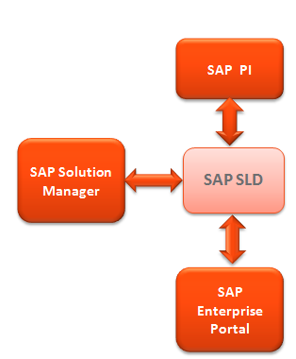
Topology
Central Organization
One single SLD for entire customer enterprise network
Advantages
Easy setup + low operation effort
No redundancy, consistent foundation
Drawbacks
High demand on SLD regarding availability and stability
Different user groups (Developers, Administrators, …) are working within the production SLD
Data of all systems visible/accessible
Copyright © Capgemini 2016. All Rights Reserved
9

Slide 30
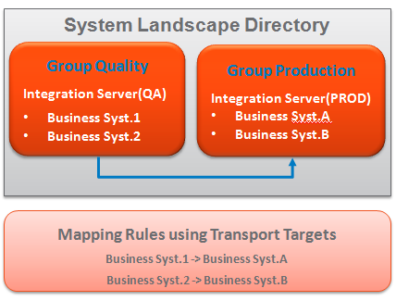
Topology
Central Organization
Business System Groups for Transport Targets
When using a single SLD for your entire system landscape, define groups of business systems and transport targets so that you can map and manage each part of your system landscape independently.
Business system groups are used to distinguish between different parts of your system landscape.
- Transport targets can be used to map the names of the business systems in different business system groups to each other.
Copyright © Capgemini 2016. All Rights Reserved
9

Slide 31
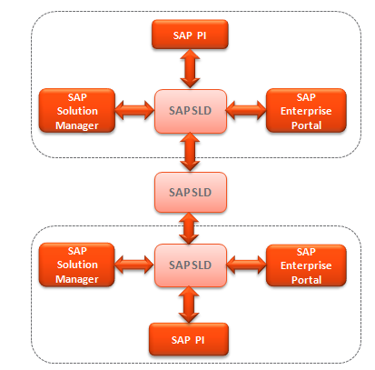
Topology
Distributed Organization
Several distributed SLDs
Advantages
- Availability improved
- Restricted views possible
- Environments can be isolated
Drawbacks
- Higher operation effort
- Several CIM model updates required
- Possible synchronization
Copyright © Capgemini 2016. All Rights Reserved
9

Slide 32
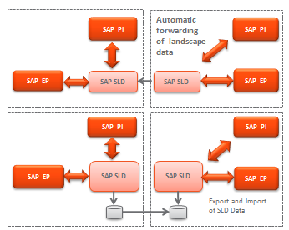
Topology
Synchronization of Distributed SLDs
If you have several SLDs, you might have to synchronize SLD data
Synchronization means interchange/ forwarding of SLD data
Synchronization can be done in two ways.
Automatic forwarding of only certain SLD data
Manual export/import
Copyright © Capgemini 2016. All Rights Reserved
9
Notes:
SLD Synchronization : http://help.sap.com/saphelp_nw73ehp1/helpdata/en/48/C46668095735B6E10000000A42189D/content.htm
Automatic forwarding of only certain SLD data
Automatically/regular sync
Data Supplier Bridge method :Only data received from SLD data suppliers, no manually entered data, no filtering!
Fully Automatic Sync method : All the CIM content are synchronized
Manual export/import
Manual/one time sync
All data can be synced (selective!)
Can result in high operation effort

Slide 33
Summary
SLD is the centralized information provider in your system landscape
- SLD helps in reducing the redundancy of system landscape information.
- SAP systems inside the landscape report data automatically to the SLD.
SLD serves as the landscape data foundation for applications based on it.
Based on your requirements, SAP offers different options for running SLD in your landscape
- Plan the SLD landscape strategy well in advance.
- Starting point: Planning Guide – SLD.
Copyright © Capgemini 2016. All Rights Reserved
9

Slide 34
SAP Process Integration
Introduction
1
2
Application Environment
3
Demonstration
4
Hands On
5
HelpMe
Copyright © Capgemini 2016. All Rights Reserved
24

Slide 35
System Landscape Directory Demo
SLD Demo
Copyright © Capgemini 2016. All Rights Reserved
26

Slide 36
SAP Process Integration
Enterprise Service Repository
Day 2
16th – 20th March 2020
Trainer: Gopal
Kirti

Slide 37
Enterprise Service Repository
Agenda
1
Overview and Concepts
Software components and namespaces
Interface Objects
Mapping Objects
2
3
4
Copyright © Capgemini 2016 All Rights Reserved
2

Slide 38
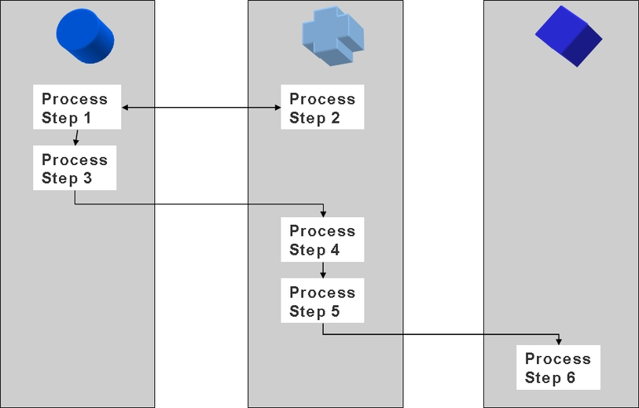
Business Process in a distributed landscape
Note: Before starting an PI Integration project, a component view of the business process requirements must be established.
Copyright © Capgemini 2016. All Rights Reserved
3

Slide 39
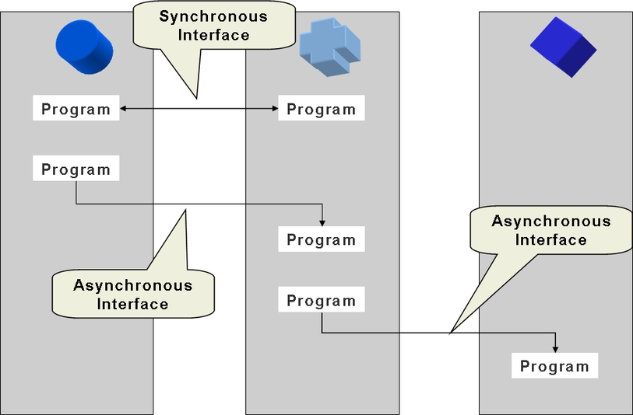
External interfaces in a distributed landscape
PI Integration is interface-driven.
An interface represents:
The transfer of data between two components
Synchronous or asynchronous message exchange
Copyright © Capgemini 2016. All Rights Reserved

Slide 40
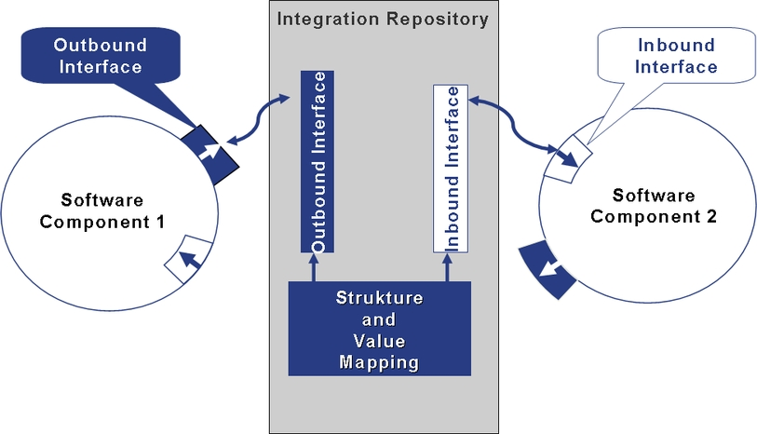
Software Components, interfaces and mappings
Copyright © Capgemini 2016. All Rights Reserved
6

Slide 41

Enterprise Service Repository
Definition:
The ES Repository provides a central modeling and design environment for creating and managing enterprise services. It provides An integrated modeling environment where you define high level models such as the Process Component models, Integration Scenario models, and so on.
End-to-end support for defining SOA artifacts such as service interface, data type, message type, and so on. It also supports the reuse of artifacts.
You access the ES Repository using the ES Builder. It helps to define and manage objects in the ES Repository.
You can organize content in the ES Repository into software components versions, namespaces, and folders. Organizing content eases navigation, helps to reuse objects, and group similar objects.
SAP or 3rd party Cloud
Systems
Non-SAP Cloud
SAP or 3rd party On- premise
SAP On- premise
SAP or 3rd party On- premise Systems
non-SAP On-
premise
Copyright © Capgemini 2016. All Rights Reserved
7

Slide 42

There are two modeling environments in the Enterprise Services Repository:
Process Components Architecture Models
SAP works with this environment to create models for applications in the SAP Business Suite. These models are shipped to customers. You can create your own models in the ES Repository.
Process Integration Scenarios
This modeling environment in the ES Repository was part of previous SAP NetWeaver PI releases and continues to be supported in the latest release. It concentrates on the modeling of the exchange of messages between application components.
Copyright © Capgemini 2016. All Rights Reserved

Slide 43
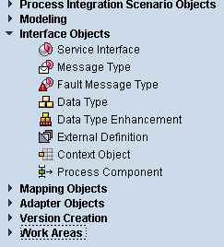
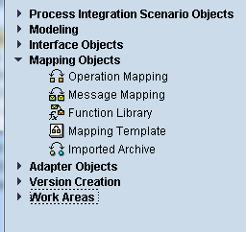
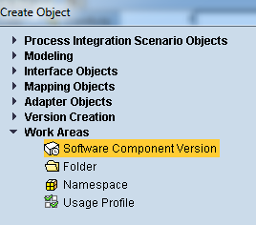
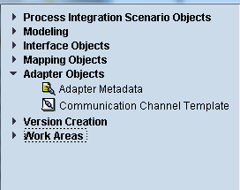
ES REPOSITORY OBJECTS
Copyright © Capgemini 2016. All Rights Reserved

Slide 44


Enterprise Service Repository
Software components and namespaces

Slide 45
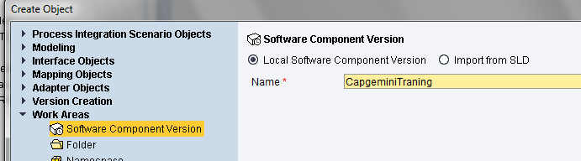
Software component version
Primary container for all Enterprise Service Repository objects
Imported directly from the SLD
Usage dependencies from SLD are reflected in the Repository (‘Basis objects‘)
For each software component version, the following can be assigned:
A connection to an existing SAP system for the import of IDoc/RFC interfaces
One or more namespaces
Copyright © Capgemini 2016. All Rights Reserved
9

Slide 46
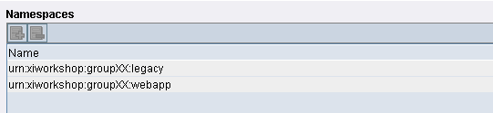
Namespaces
(Globally) unique identifier for related Enterprise Service Repository objects
Usually vendor-based
Same concept as XML namespaces
Several namespaces can be assigned to the same SWCV
Naming convention:
URL http://sap.com/xi/demo
URN urn:sap-com:xi:demo
(URL without protocol assignment)
Copyright © Capgemini 2016. All Rights Reserved
10

Slide 47
Enterprise Service Repository
C
Interface objects
Copyright © Capgemini 2016. All Rights Reserved
11

Slide 48
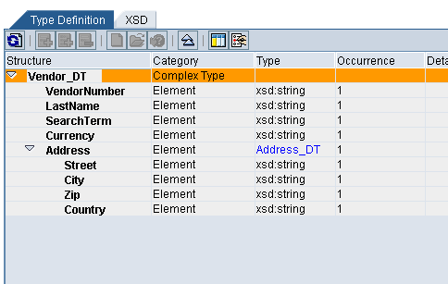
Interface Objects: Data type
Data types are the most basic entity to define the structure of XML elements
Equivalent to XML Schema (XSD)
Data type editor provides all XSD basic data types.
Nesting of data types possible
Export of data type in XSD format possible
Copyright © Capgemini 2016. All Rights Reserved
12

Slide 49
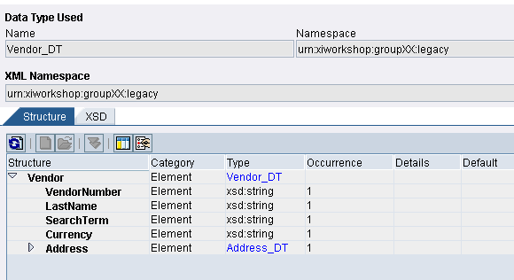
Interface Objects: Message type
The Message type corresponds to the root of the XML message
Name and namespace must match exactly the root of XML Business documents
The Message type references one single data type
XSD representation available for export
Copyright © Capgemini 2016. All Rights Reserved
13

Slide 50
Interface Objects: Service Interface
The Service Interface is the highest-level representation of XML metadata.
Inbound or outbound (respective to the application), or abstract.
Synchronous or asynchronous
Asynchronous refers to one message type
Synchronous refers to two message types (request and response)
References fault message types for exception handling
WSDL representation available for export
Starting point for proxy generation (ABAP and Java)
Context objects can be assigned
Constructed with message types, data types, RFC or IDoc metadata and
external definitions.
Describes single or multiple operations to be implemented.
Types of Interface Patterns are stateless, stateless (XI 3.0-compatible),
stateful and tu&c/c.
Operation patterns depend on the interface pattern eg. Normal, confirm etc
Copyright © Capgemini 2016. All Rights Reserved
14

Slide 51
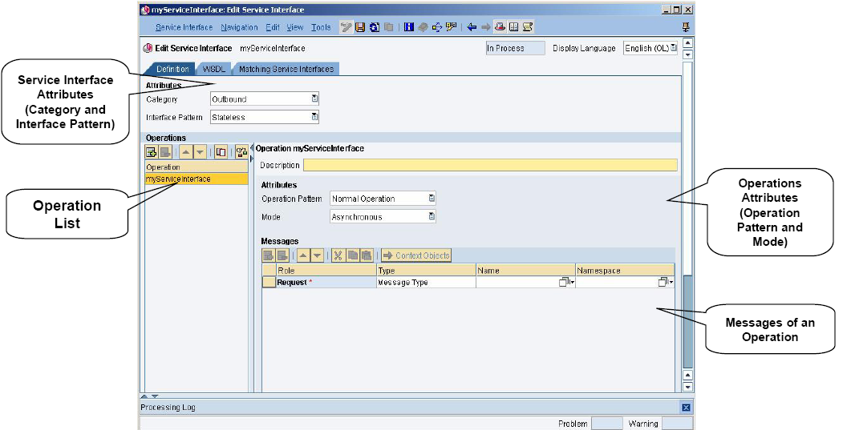
Service Interface : UI Layout
Copyright © Capgemini 2016. All Rights Reserved
15

Slide 52
Service Interface : Interface Pattern
Interface pattern describes the type of communication that is to be executed in the message.
Stateless : Messaging runtime does not support saving the status of message once message exchange has been executed successfully.
Stateful : Messaging runtime supports saving the status of message once message exchange has been executed successfully.
TU&C/C : Tentative Update and Confirm/Compensate provides reliable means of providing synchronous call updates in a transactional context.
Operations: Single or multiple operations can be specified.
Operation Pattern: Depends on the interface pattern.
Mode: Asynchronous/Synchronous.
Copyright © Capgemini 2016. All Rights Reserved
16

Slide 53
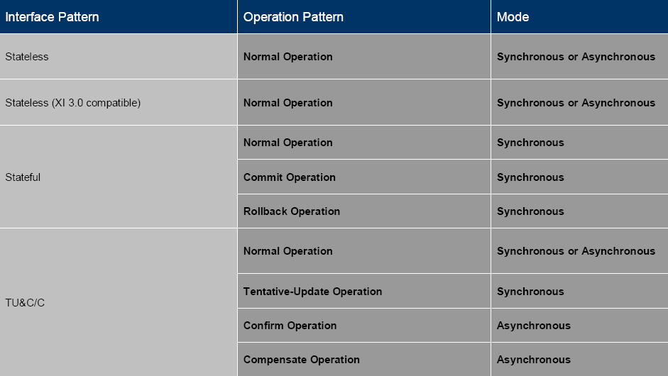
Interface Pattern and Operations Pattern
Each interface pattern has specific operation patterns and modes.
Copyright © Capgemini 2016. All Rights Reserved
16

Slide 54
Enterprise Service Repository
Mapping objects
Copyright © Capgemini 2016. All Rights Reserved
17

Slide 55
Mapping concepts
Mapping
Transformation from one message structure to another
Transformation rules defined by mapping program
<hh:book-flight xmlns:hh="...">
<hh:customer>
<hh:first-name>Micheal</hh:first-name>
<hh:surname>Moore</hh:surname>
</hh:customer>
<hh:booking-data>
<hh:airline>Airline Kingdom</hh:airline>
<hh:connection>AK087</hh:connection>
<hh:date>2001-11-22</hh:date>
<hh:class>business</hh:class>
</hh:booking-data>
</hh:book-flight>
Value Mapping
<ak:BookFlight xmlns:ak="...">
<ak:Date>22.11.2001</ak:Date>
<ak:Flight>087</ak:Flight>
<ak:Passenger>Micheal Moore</ak:Passenger>
<ak:Class>2</ak:Class>
<ak:Agency>Happy Holiday</ak:Agency>
</ak:BookFlight>
piStructure Mapping
ng
Structure Mapping
Copyright © Capgemini 2016. All Rights Reserved
18

Slide 56
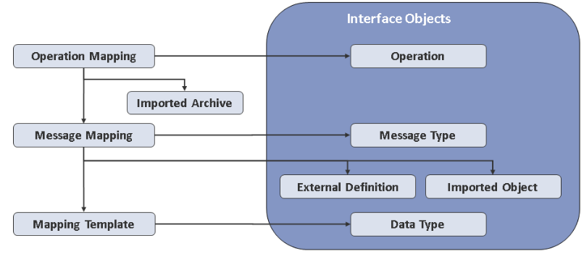
Mapping Objects in SAP NetWeaver PI
SAP Cloud for Customer helps align
an organization around its customer.
It provides solutions for marketing,
sales and customer service teams.
Copyright © Capgemini 2016. All Rights Reserved
19

Slide 57
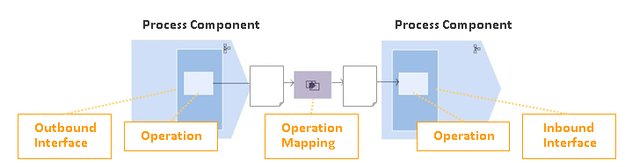
Mapping concepts
SAP Cloud for Customer helps align
an organization around its customer.
It provides solutions for marketing,
sales and customer service teams.
Copyright © Capgemini 2016. All Rights Reserved
19

Slide 58
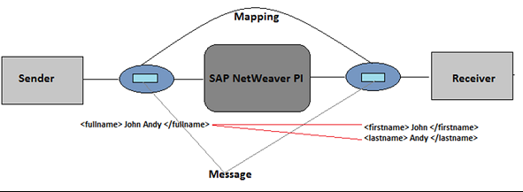
Mapping concepts
SAP Cloud for Customer helps align
an organization around its customer.
It provides solutions for marketing,
sales and customer service teams.
Copyright © Capgemini 2016. All Rights Reserved
19

Slide 59
Mapping concepts
At design time, the mapping is defined in the Enterprise Services Repository in terms of operation mappings.
Operation mappings connect two (or more) service interfaces with one another.
Mapping programs used to map other mapping objects (mapping programs) to implement the mapping between the message types. Message types can be realized in the following different ways:
Message mappings are created graphically using the mapping editor in the Integration Builder.
Java mappings are created externally and then imported.
XSL transformations are created externally and then imported.
ABAP mappings classes are created and referenced on the Integration Server (in the ABAP stack).
SAP Cloud for Customer helps align
an organization around its customer.
It provides solutions for marketing,
sales and customer service teams.
Copyright © Capgemini 2016. All Rights Reserved
19

Slide 60
Mapping Objects: Message mapping
SAP Cloud for Customer helps align
an organization around its customer.
It provides solutions for marketing,
sales and customer service teams.
Graphical mapping tool
Graphically define mapping rules between source and target message types
Queue-based model allows for handling of extremely large documents
Drag-and-drop
Generates internal Java code
Built-in and user-defined functions (in Java)
Integrated testing tool
Copyright © Capgemini 2016. All Rights Reserved
19

Slide 61
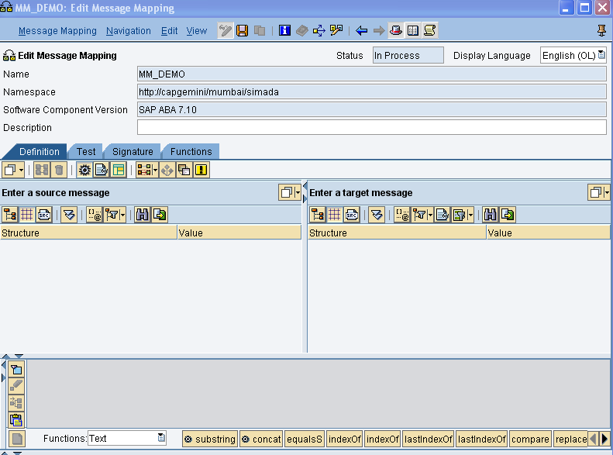
Message Mapping: Mapping Editor
Define parameters for parameterized message mapping
SAP Cloud for Customer helps align
an organization around its customer.
It provides solutions for marketing,
sales and customer service teams.
Object Tool Bar
Define function Libraries
Target Structure
Source Structure
Structure Overview
Standard Function list
Data Flow Editor
Copyright © Capgemini 2016. All Rights Reserved
19

Slide 62
Main Function Area of the Mapping Editor:
Signature: To define parameters for parameterized mapping.
Function: To create Function library so that UDF’s are globally available.
Object Toolbar :The functions in the Object Toolbar relate to the entire mapping. For example, you can save your mapping or automatically assign fields with the same name to each other.
Structure Overview: Import an XML or XSD file for both the source structure and the target structure.
Data-Flow Editor: Describe the flow of data from one or more source fields.
Copyright © Capgemini 2016. All Rights Reserved
21

Slide 63
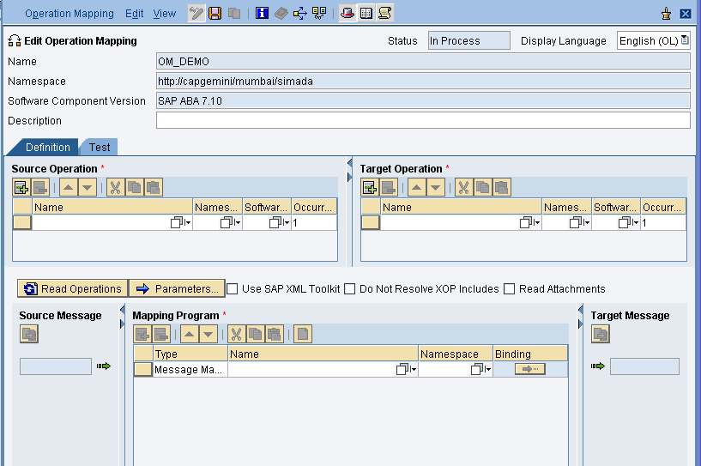
Mapping Objects: Operation Mapping
Perform several mapping programs for the transformation of a request or response message.
For synchronous service interfaces, a request and response mapping can be provided.
Define parameter in parameter messages mapping
Bind parameter in parameter messages mapping
Basic Setting
Copyright © Capgemini 2016. All Rights Reserved
23

Slide 64
Mapping objects: imported archives
The object type ‘imported archive’ is for importing externally defined programs into the Enterprise Service Repository:
XSLT stylesheets
Java mappings
Java extensions to XSLT mappings
Java classes to be imported in a user-defined function for message mapping
All files to be imported must be archived (ZIP or JAR format)
The archive is uploaded from user workstation.
Enterprise Service Repository can serve as central maintenance location for imported objects
XSLT and text files can be edited directly from IR.
Java CLASS files must be edited and recompiled locally, then re-imported.
Copyright © Capgemini 2016. All Rights Reserved
23

Slide 65
Thank You
Copyright © Capgemini 2016. All Rights Reserved
26

Slide 66
Enterprise Service Repository Demo
ESR Demo
Copyright © Capgemini 2016. All Rights Reserved
26

